Slide 1

MAT205: Abstract Algebra II
17. Factorization
Ma, Jia-Jun

Slide 2
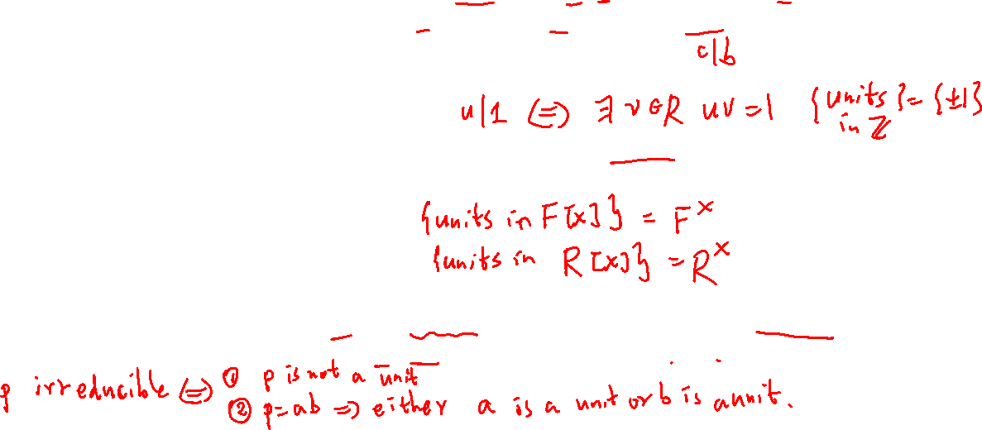
Divides
Unit:
Irreducible

Slide 3
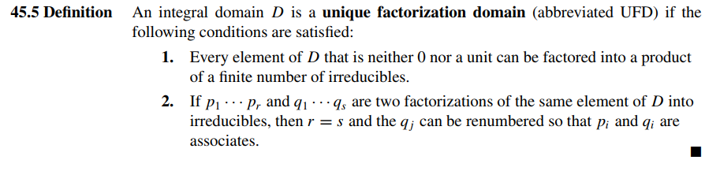
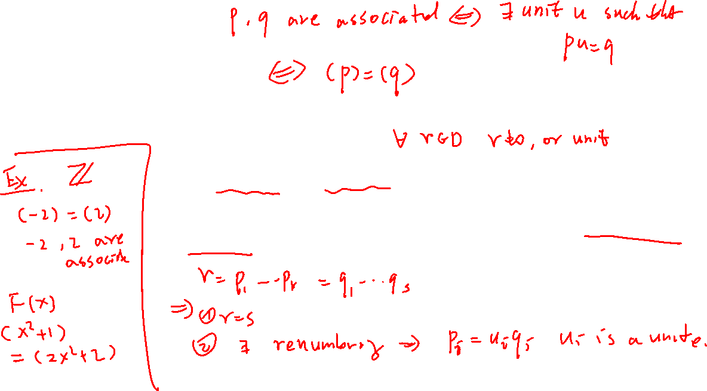
UFD

Slide 4

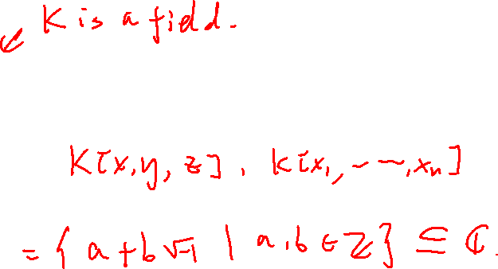
Example
$ℤ$
$ℤ\left[x\right], K\left[x\right]$
$K[x,y]$
$ℤ[\sqrt{−1}]$

Slide 5

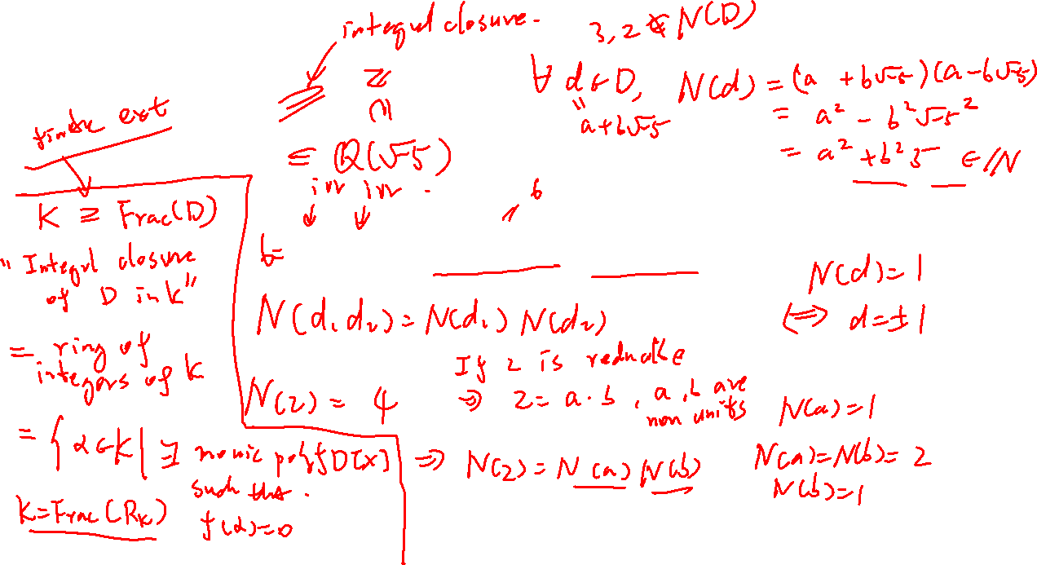
Non-Example
$D≔ℤ\left[\sqrt{−5}\right]$
$$2⋅3 =(1+\sqrt{−5})(1−\sqrt{−5})$$

Slide 6

PID

Slide 7
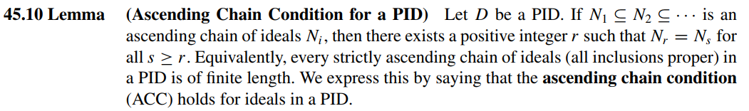
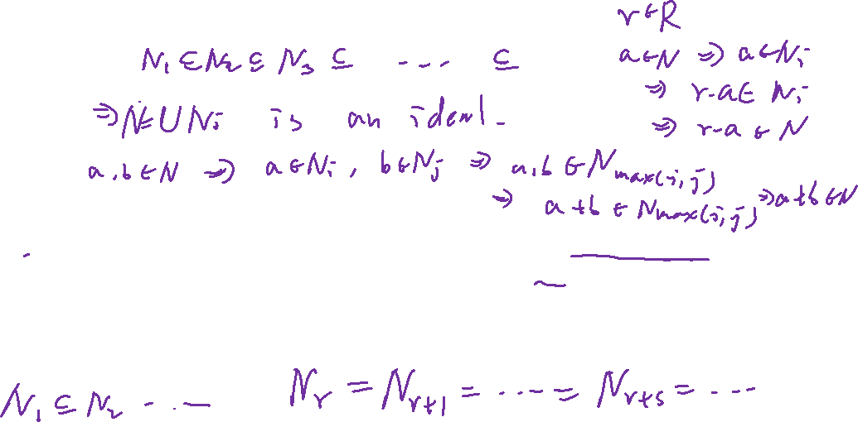

Slide 8
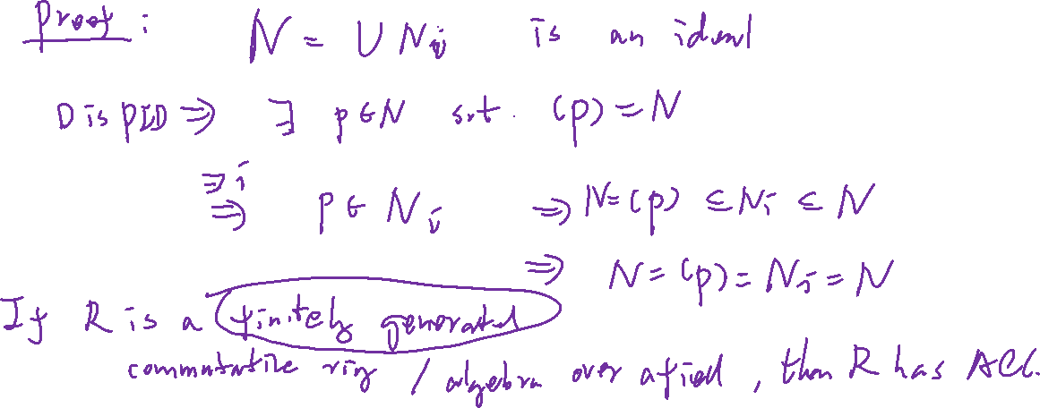

Slide 9
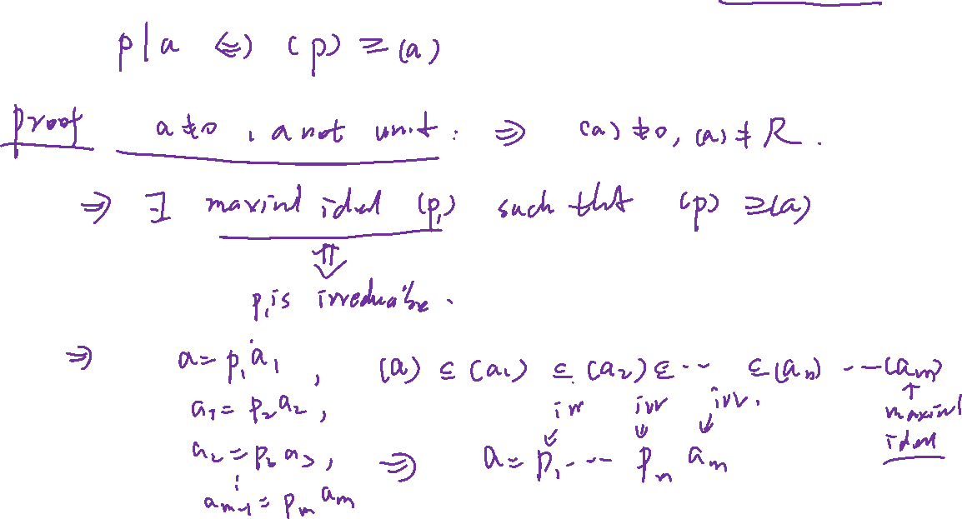

Slide 11
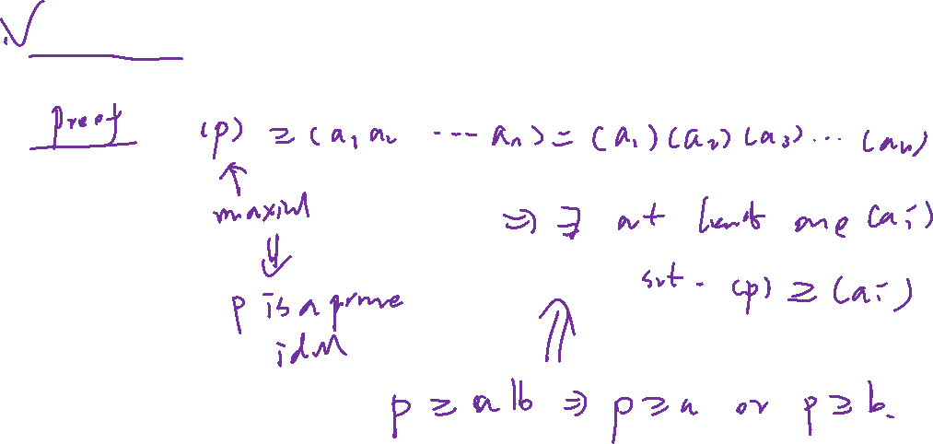

Slide 12
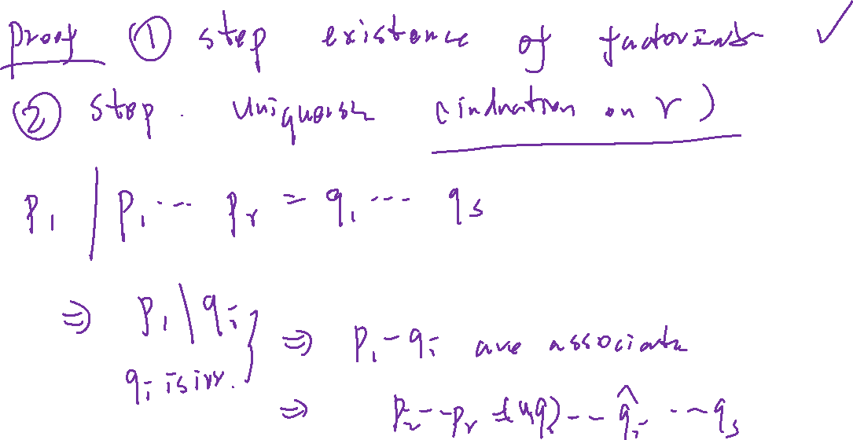

Slide 14
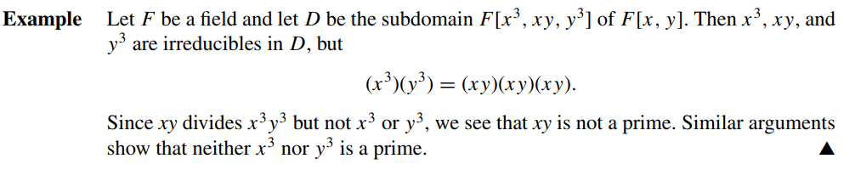
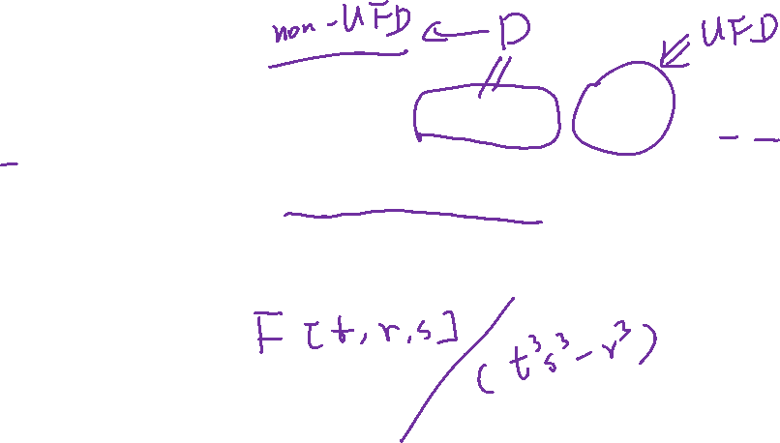
Prime in non-PID

Slide 18

Example: UFD$⊃$ PID

Slide 19
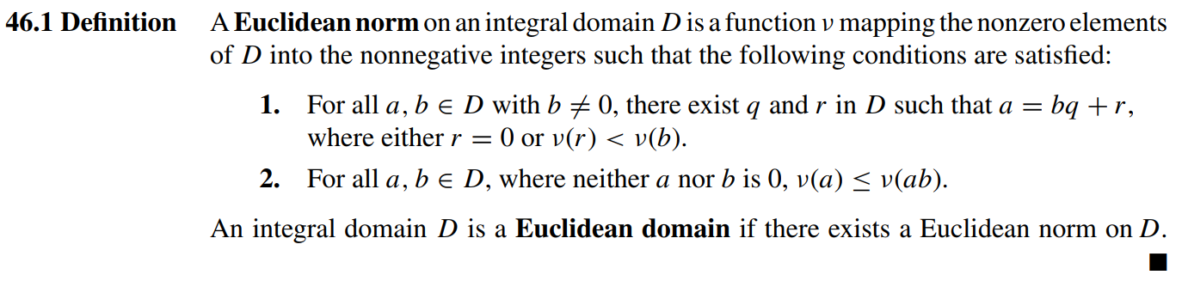
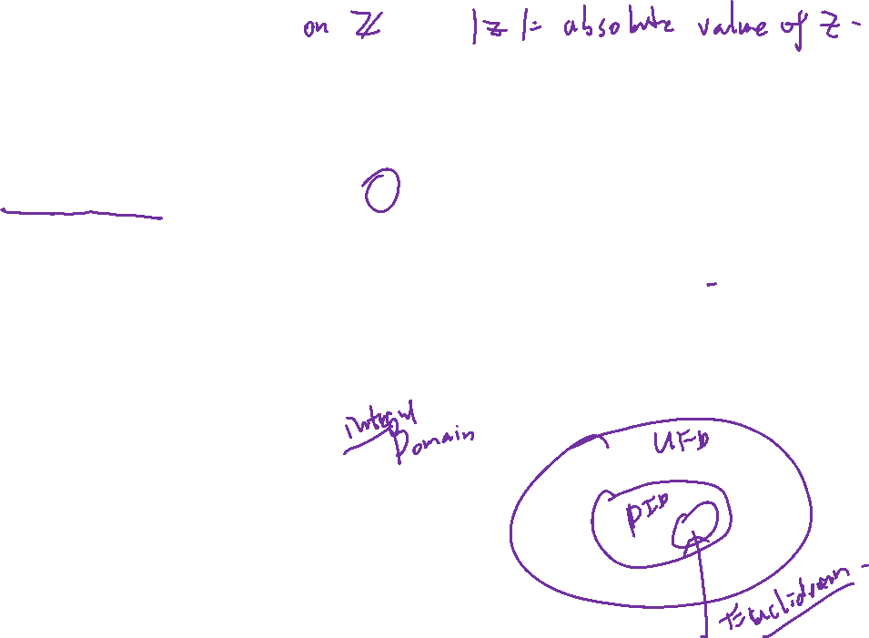
Euclidean domain

Slide 20
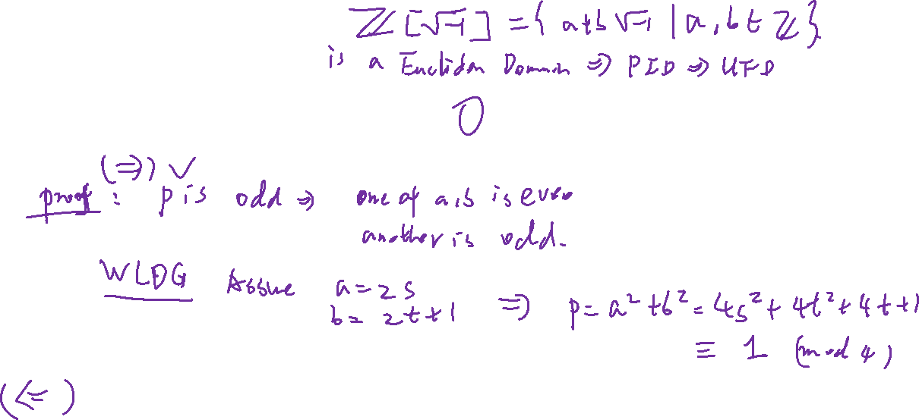
Gauss Integer

Slide 21
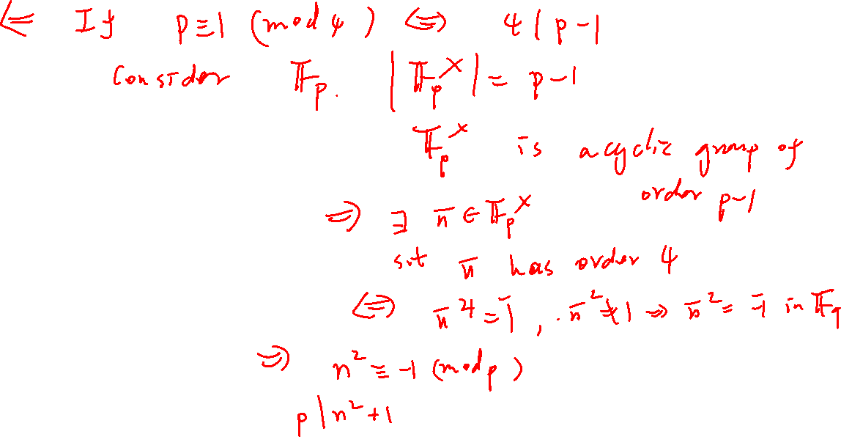

Slide 22
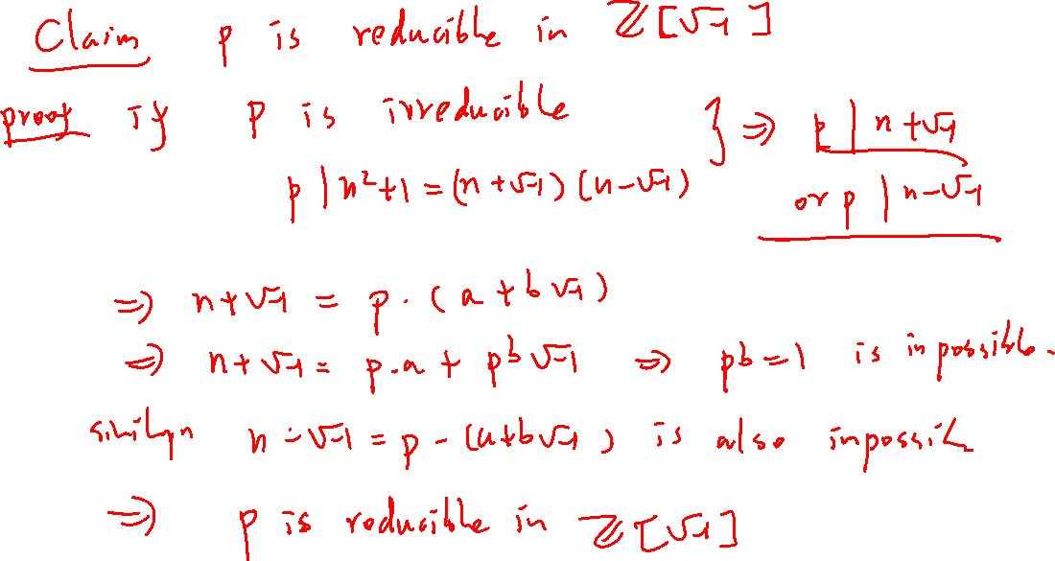

Slide 23
